Slide 1
NLP Final Project Presentation
Automated Essay Scoring System
NLP Ninjas
2024/06/03
M1261018 - Chaithra (Lily)
M1261015 - Gomathi
M1261026 - Nguyen Anh Khoa

Slide 2
Table of contents
01
Introduction
02
Datasets
Models tested
04
Evaluation Metrics
3
03
05
Results and conclusion

Slide 3
Introduction
01

Slide 4
Introduction
Automated Essay Scoring (AES): the task of employing computer technology to grades written text automatically.
Automated essay scoring can lead to more accessible educational tools and support for both students and educators
By automating this process, we can ease the workload for teachers and give students prompt feedback
Input: An essay written by a student. This text is processed and analyzed to evaluate various aspects such as grammar, coherence, logic, and relevance to the topic.
Output: A numerical score, grade or qualitative feedback representing the quality of the essay.

Slide 5
Dataset
02

Slide 6
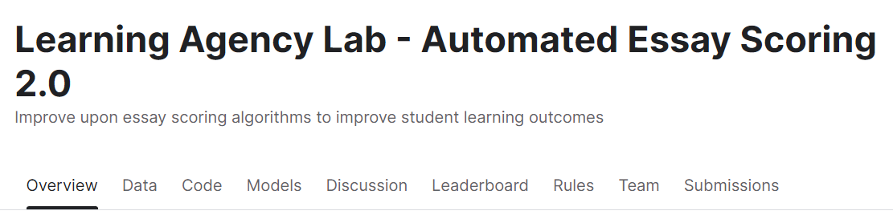
Dataset for AES
Most notable datasets:
Automated Student Assessment v2 (ASAP)
About 17307 student-written argumentative essays.
Scored on a scale from 1 to 6
Notes:
CRP: predicting the reading ease of excerpts from literature

Slide 7
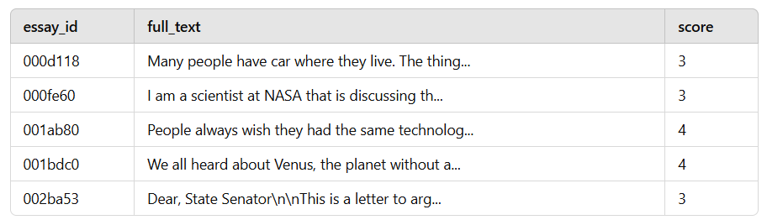
Dataset

Slide 8
Models tested
03

Slide 9
Models tested
Transformers based methods
Fine-tuning RoBERTa
Fine-tuning DistilBert
Instruction fine-tuning Mistral-7B
Notes:
CRP: predicting the reading ease of excerpts from literature

Slide 10
Criteria Learned by the Model to Score
Semantic Content: Understanding the relevance and depth of content by learning from context-aware embeddings.
Coherence and Structure: Capturing the logical flow and structure of the essay through attention mechanisms.
Language Use: Recognizing correct grammar, vocabulary usage, and stylistic elements through learned embeddings and patterns in the data.
Consistency: Ensuring that predictions are consistent with the types of essays and scoring patterns observed during training.

Slide 11
Evaluation metrics
05

Slide 12
Evaluation Metric
For ASAP dataset:
Accuracy and Agreement Metrics:
Cohen's Kappa score can be used to evaluate the agreement between the scores assigned by human raters and those predicted by an automated system.
Range 0 to 1 :
0 means non accurate predictions
1 means accurate predictions
Notes:
A perfect score 1 is granted when both the predictions and actuals are the same,
whereas 0 is when the predictions are very far away
CRP: predicting the reading ease of excerpts from literature

Slide 13
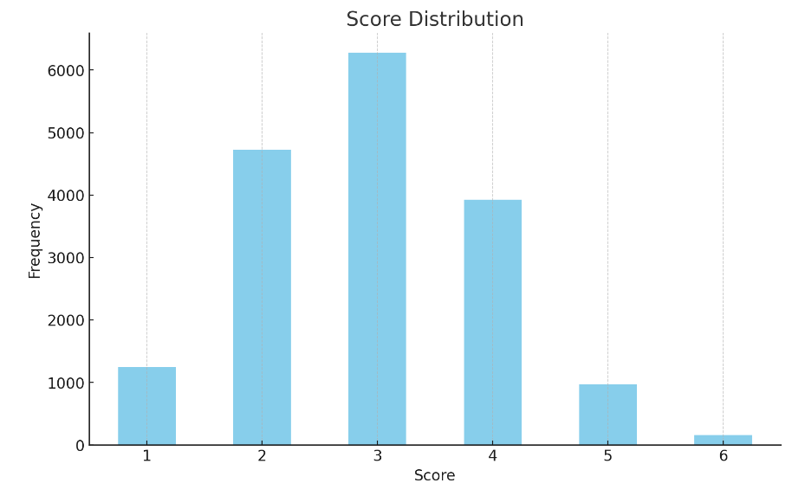
Distribution of scores in Training dataset

Slide 14
Results of RoBERTa
03
RoBERTa, which stands for "Robustly optimized BERT approach," is a transformer-based model developed by Facebook AI Research as an improvement over BERT (Bidirectional Encoder Representations from Transformers)

Slide 15
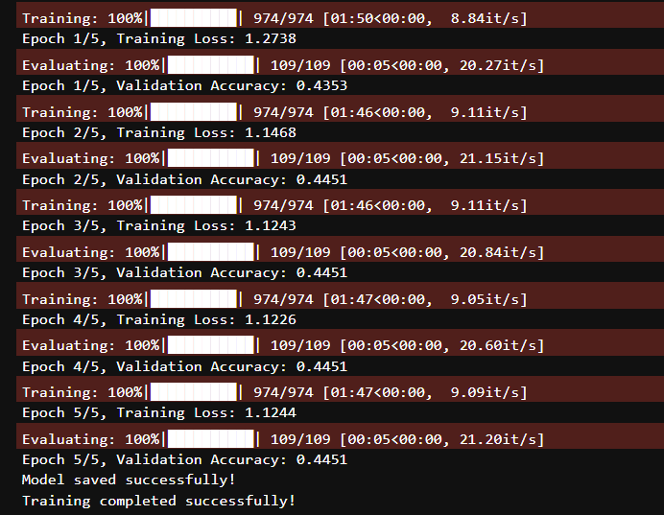
Training details
Epochs = 5
Batch = 16
90% and 10% random split of train data
44.5% accuracy.
Notes:
CRP: predicting the reading ease of excerpts from literature

Slide 16
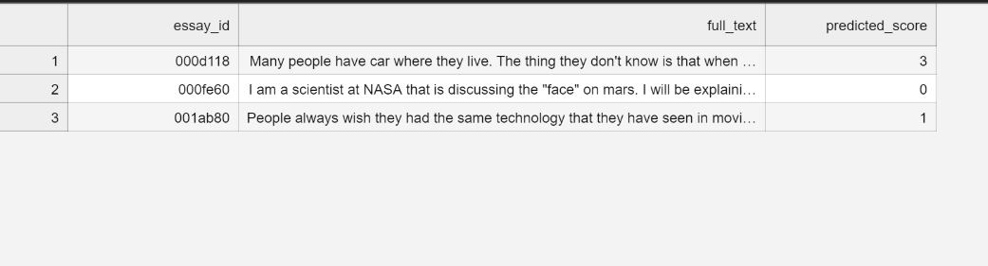
Predictions

Slide 17
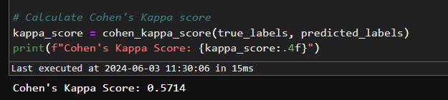
Cohen’s Kappa Score
A score of 1 means perfect agreement with human raters.
0 indicates agreement equivalent to chance.
Negative scores mean the agreement is worse than chance.

Slide 18
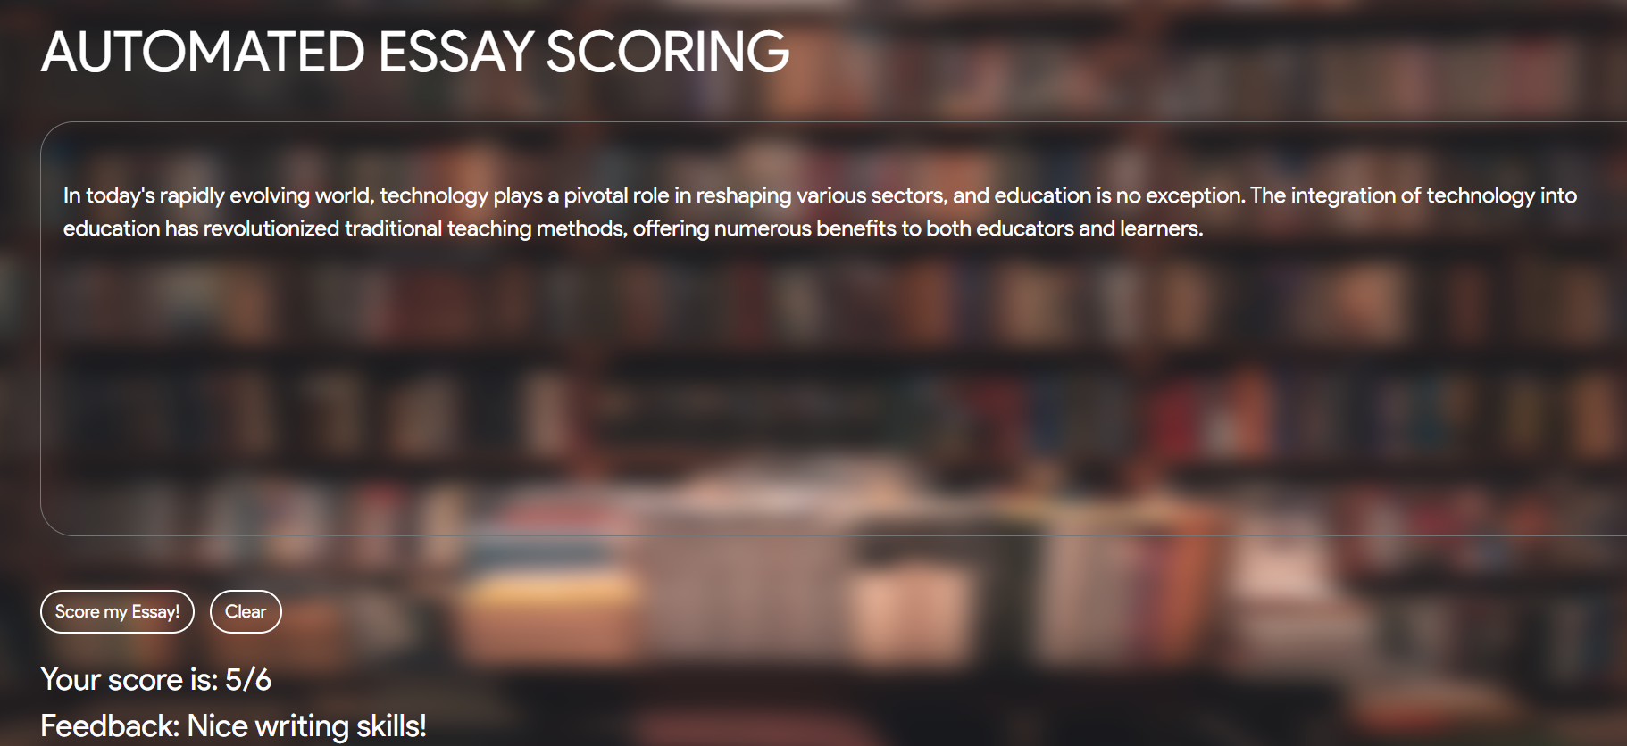

Slide 19
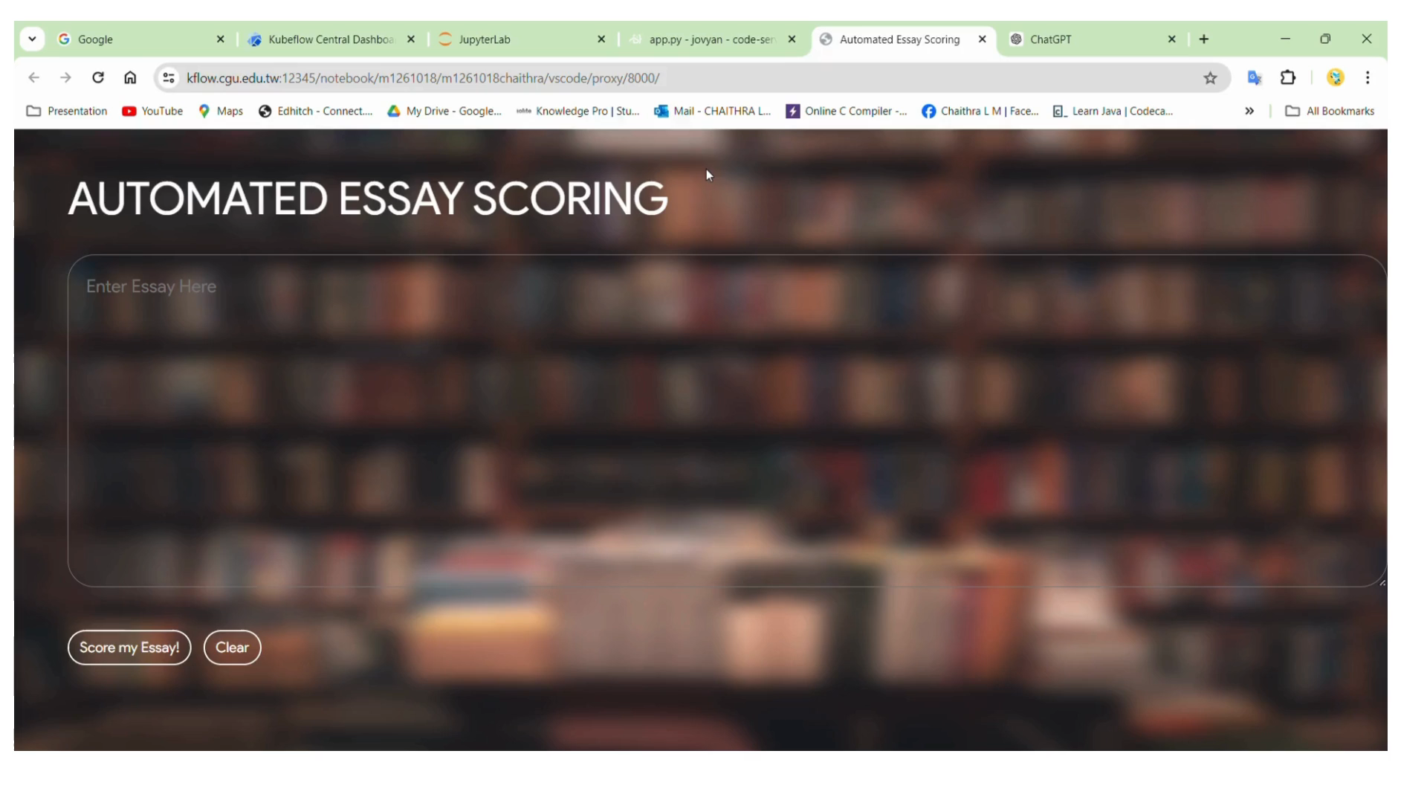
Demo Video of Roberta for AES
AES DEmo.mp4 => URL for Demo video

Slide 20
Results of DistilBERT
04
DistilBERT is a smaller, faster, cheaper, and lighter version of BERT (Bidirectional Encoder Representations from Transformers). Developed by Hugging Face, it aims to retain most of BERT's capabilities while being more efficient.

Slide 21
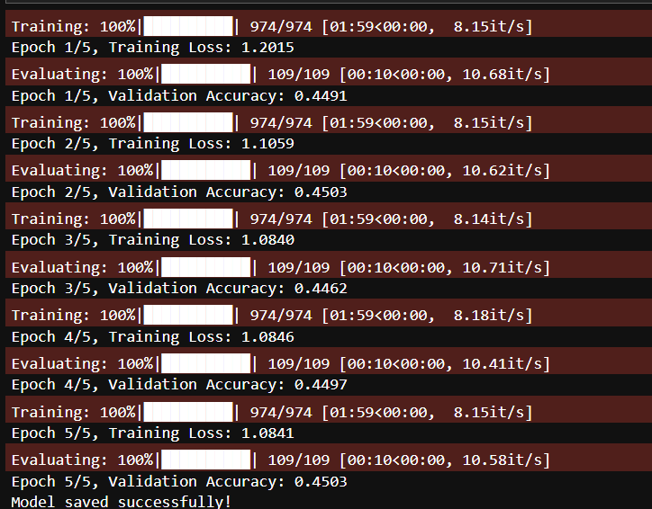
Results of DISTILBERT
Training
Epochs = 5
Batch = 16 13510/1
90% and 10% random split of train data
45.03% accuracy.

Slide 22
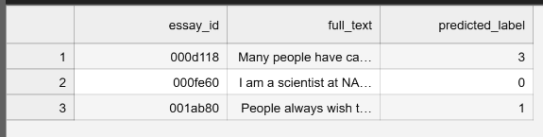
Prediction

Slide 23
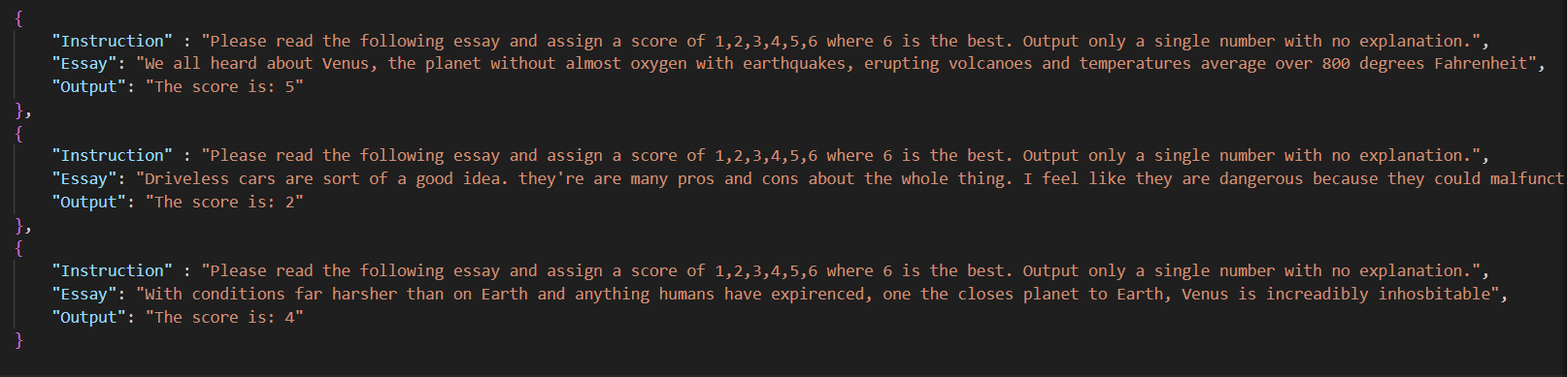
Instruction fine-tuning of Mistral-7B
Train LLMs on specific input-output examples, allowing for more controlled and desired outputs.
Enhance model behavior, reliability, and safety in various applications.
Notes:
Nowadays, large LLM (like Mistral, Llama, Claude, Gemini, Vicuna, etc) are popular and I'm curious to see how they compare to "smaller" models like RoBERTa, BERT on basic tasks like classification and regression!

Slide 24
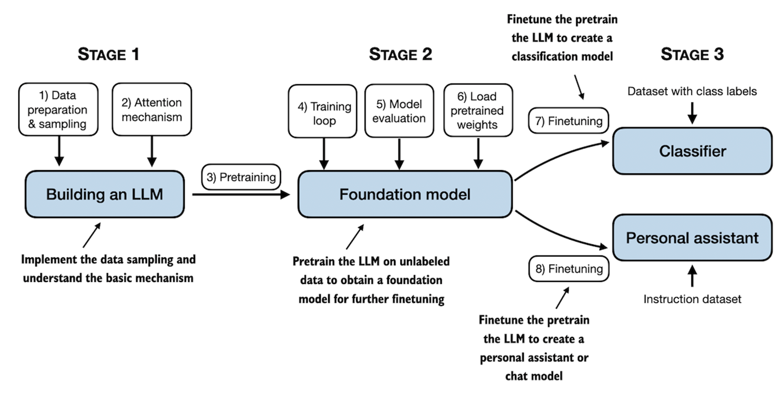
Instruction fine-tuning
Instruction fine-tuning
https://github.com/rasbt/LLMs-from-scratch

Slide 25
Instruction fine-tuning
Training configuration
Mistral-7B-v0.1 (fp16)
Parameter-efficient fine-tuning (PEFT) method: LoRA
Tesla V100 - 16GB
Batch size: 1

Slide 26
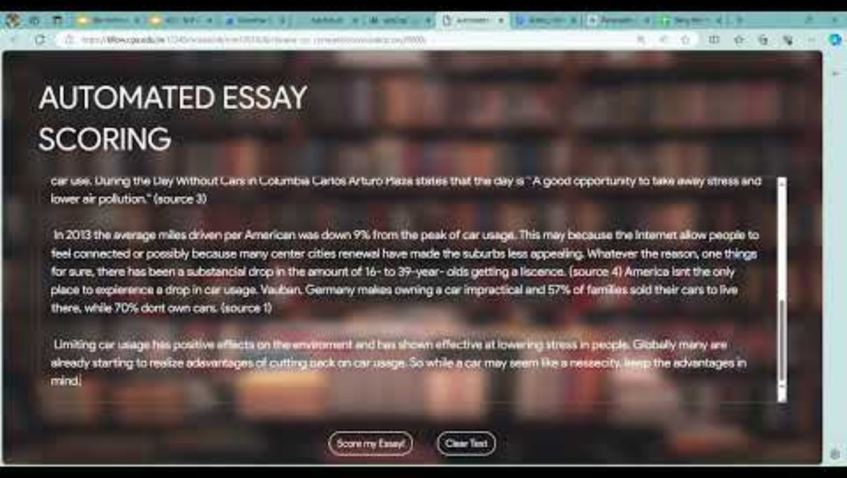
Demo video of Mistral-7B
https://youtu.be/15-DnTa3KPI?si=-hjlR388TTSMKiFl

Slide 27
Comparison Table
Model tested | Epochs | Learning Rate | Accuracy | Cohen’s Kappa score
Roberta | 5 | 1e-5 | 44.5% | 0.57
DistilBert | 5 | 1e-5 | 45.03% | 0.58
Mistral - 7B | 1 | 5e-5 | - | 0.74

Slide 28
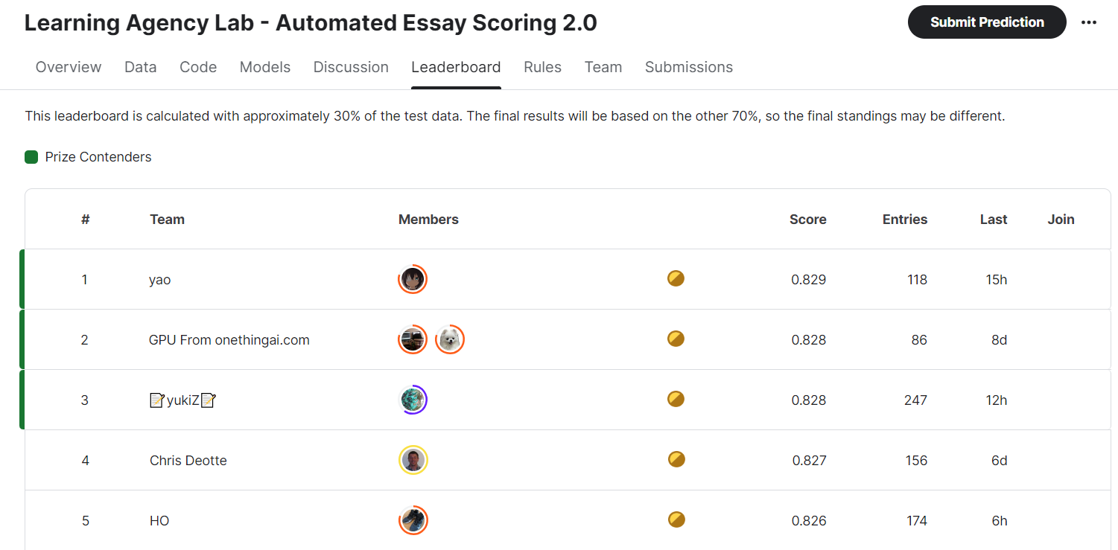
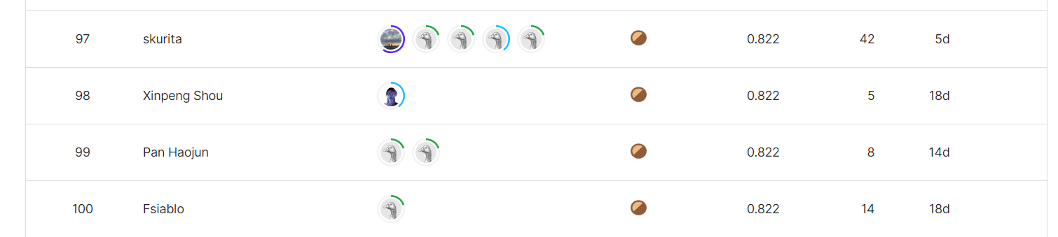
Compare with participants from kaggle

Slide 29
Conclusion
In conclusion, our extensive testing with models like RoBERTa, DistilBERT, and Mistral-7B has demonstrated their exceptional capability in providing accurate and insightful feedback for Automated Essay Scoring (AES). These models, when fine-tuned on specific AES tasks, exhibit remarkable proficiency in evaluating essays, showcasing the advancements in natural language processing.

Slide 30


